Slide 1



Full Stack Developer
Judul Mission : Mission (4)
Disusun oleh : Fadlan Khalqi - 19026
Email : fadhlan.khalqi@gmail.com
Restricted - For Student Only

Slide 2

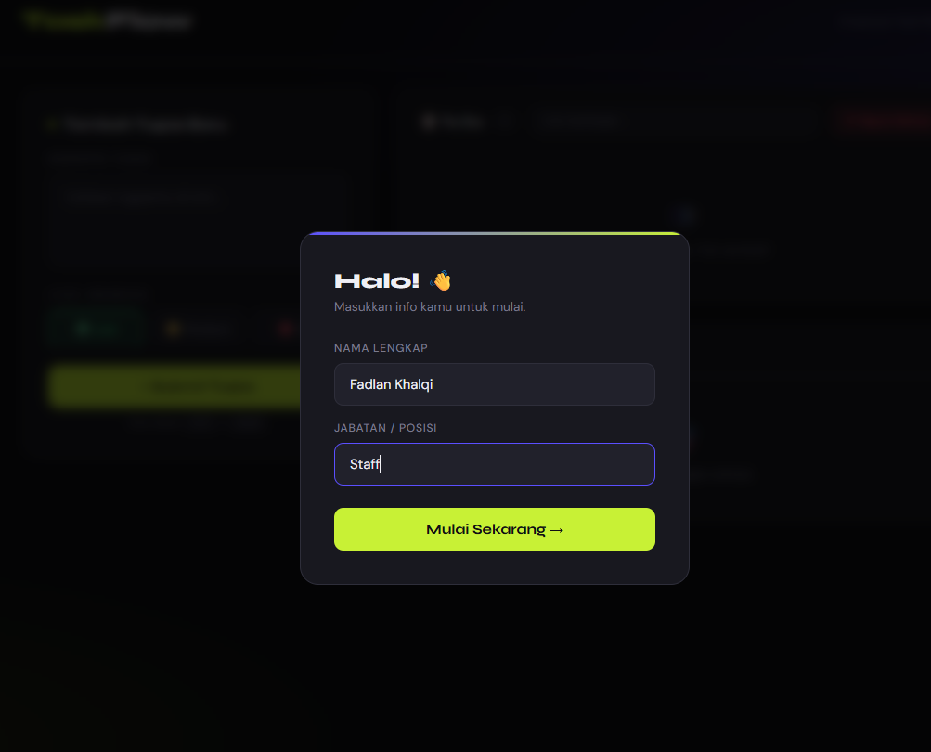
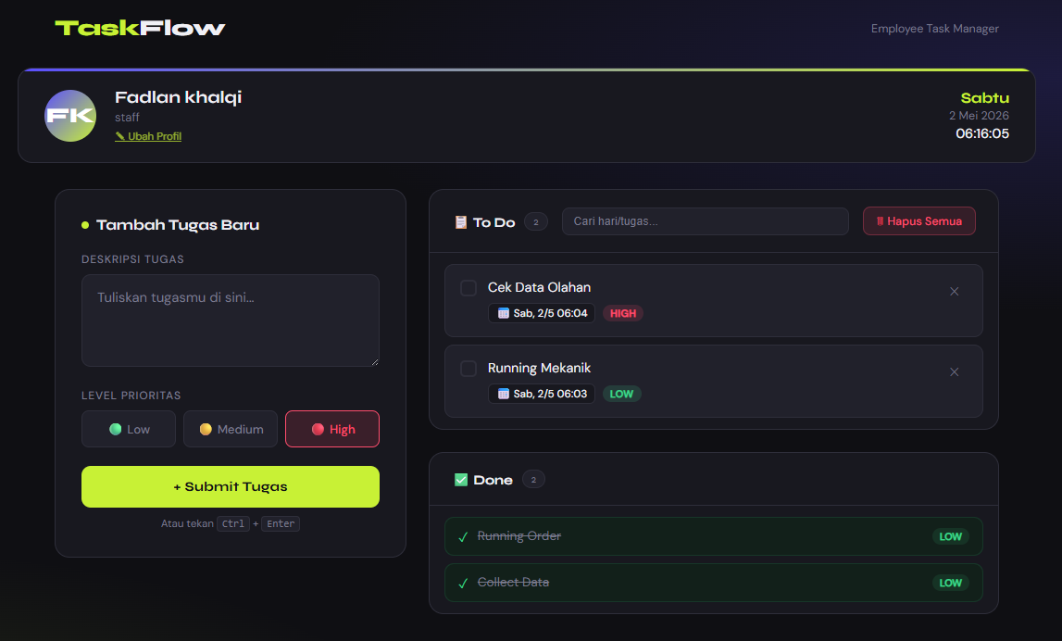
UI Registrasi Diri
UI To list

